Slide 1
Predicting High School Graduation: Tennessee Star Student Survey
Can help inform and add precision to future public education reform.
Discover which variables are most predictive of student success.
Highschool graduation has many positive externalities, for example, more informed voters, less unemployment, a more educated work force, better investment and saving strategies, etc.
If we can narrow down predictive variables of High School graduation, we can then look at what influences those predictive variables.
For example, if fourth grade reading scores are predictive of graduation and free school lunches improve reading scores then we can advocate for universal free lunches at school with empirical evidence.

Slide 2
Tennessee Star Student Survey: Data Cleaning
New levels in a subset error, fixed by running the recipe on the whole data set.
Nearest neighbor imputation on 381 variables and 11,000 observations was too computationally intensive so we used mode imputation on our dummies.
step_rm (HSGRADADD), in recipe on whole data set so when we predicted onto to test set it was not removed. We were predicting our outcome variable of (Graduate) with basically the same variable; however, we were only 97% accuracy.
Solution = (-HSGRADADD) when reading in data set at the beginning.

Slide 3
Prediction Methods
Lasso Regression, 10-Fold cross validation, tuned penalty (lambda= (10^seq(10, -10, length out = 50), 0) to minimize RMSE.
Elasticnet, 10-Fold cross validation, tuned penalty and mixture with levels 10:10 to minimize RMSE.
Support Vector Machine, 5-Fold cross validation, tuned cost = 10^seq(-4, 2, length = 10), tuned polynomial degree = 1:3 to maximize Accuracy.
Decision Tree, 5-Fold cross validation, tuned cost complexity = seq(0, 0.15, by = 0.01), tree depth = c(1,2,5,10) to maximize Accuracy.

Slide 4
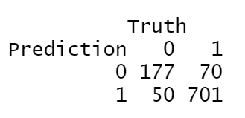
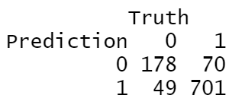
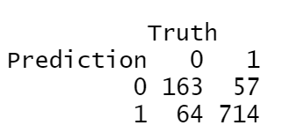
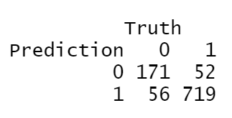
Results and Conclusions
Lasso
Elasticnet
Accuracy = 0.87976
Accuracy = 0.88076
Support Vector Machine
Decision Tree
Accuracy = 0.87876
Accuracy = 0.89178

